Slide 1
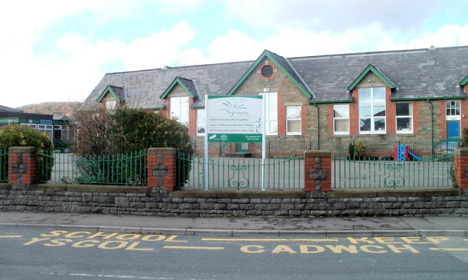
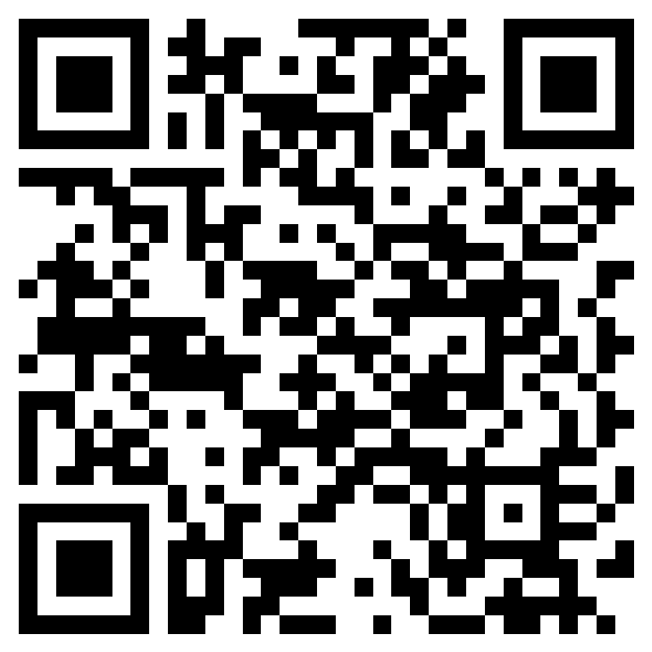

🎉 Tonysguboriau Primary School Clubs 🎉
Come join the fun and learn new skills!
⚽ Football Club
With Mr. Hussey
📅 Tuesday Nights
👥 Open to Year 5 & 6
🏃‍♂️ Get active, build teamwork, and score some goals!
🏐 Netball Club
With Mrs. Gill
📅 Thursday Nights
👥 Open to Year 3 - 6
🏃‍♂️ Learn Strategy, Coordination and have a blast!
♟️Chess Club
With Mrs. Harries
📅 Wednesday Lunch
👥 Open to Year 3 - 6
🤔 Challenge your mind and master the game!
All clubs will run from 7th September for 6 weeks ending the 16th October. After school clubs finish at 4:20pm.
Please fill out the Microsoft Form to ensure your child gets in.

